Slide 1

Switzerland Point Middle School
Expectations Assembly

Slide 2
Fairness
We want students to know what are our expectations for behavior.
We follow a system of demerits (progressive discipline)
We follow the St Johns County Code of Conduct

Slide 3
What to expect in the Dean’s office
We do investigate all incidents
We do give you an opportunity to tell your side of the story
Decisions about consequences are based upon the investigation and are in line with the St. Johns County Code of Conduct.

Slide 4

Daily Conduct
4th demerit – Sent to Dean
Lunch Detention
5th demerit – Sent to Dean
1 Day ISS
6th demerit – 2 Days ISS
7th demerit – 1 Day OSS
8th demerit – 2 days OSS
1st demerit, 2nd demerit, 3rd demerit:
Warning, Parent Notification

Slide 5





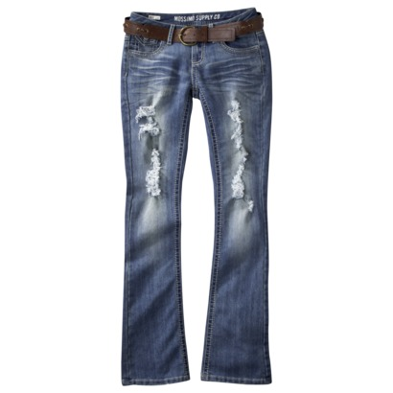



Dress Code

Slide 6


Shirts with Cold Shoulder Sleeves
These are allowed!

Slide 7

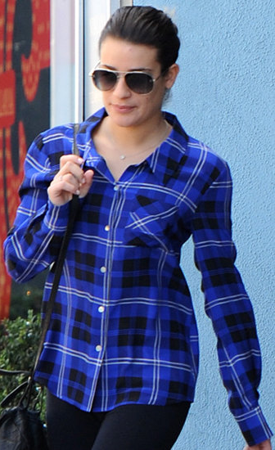
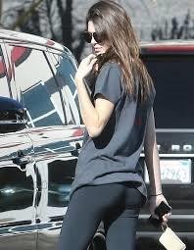
Yoga Pants/Leggings-Allowed (but with exceptions)
NO!
Shirt must be same length in the front and back and long enough to cover your butt.

Slide 8






Yoga Pants/Leggings-Allowed (but with exceptions)
YES!

Slide 9

Toys are not allowed

Slide 10
TARDY POLICY
3rd TARDY to class = lunch detention (will be issued by the Deans)
4th TARDY = 2 lunch detentions (will be issued by the Deans)
EACH TARDY AFTER #4 = 1 DAY ISS (will be issued by the Deans for each subsequent tardy)

Slide 11
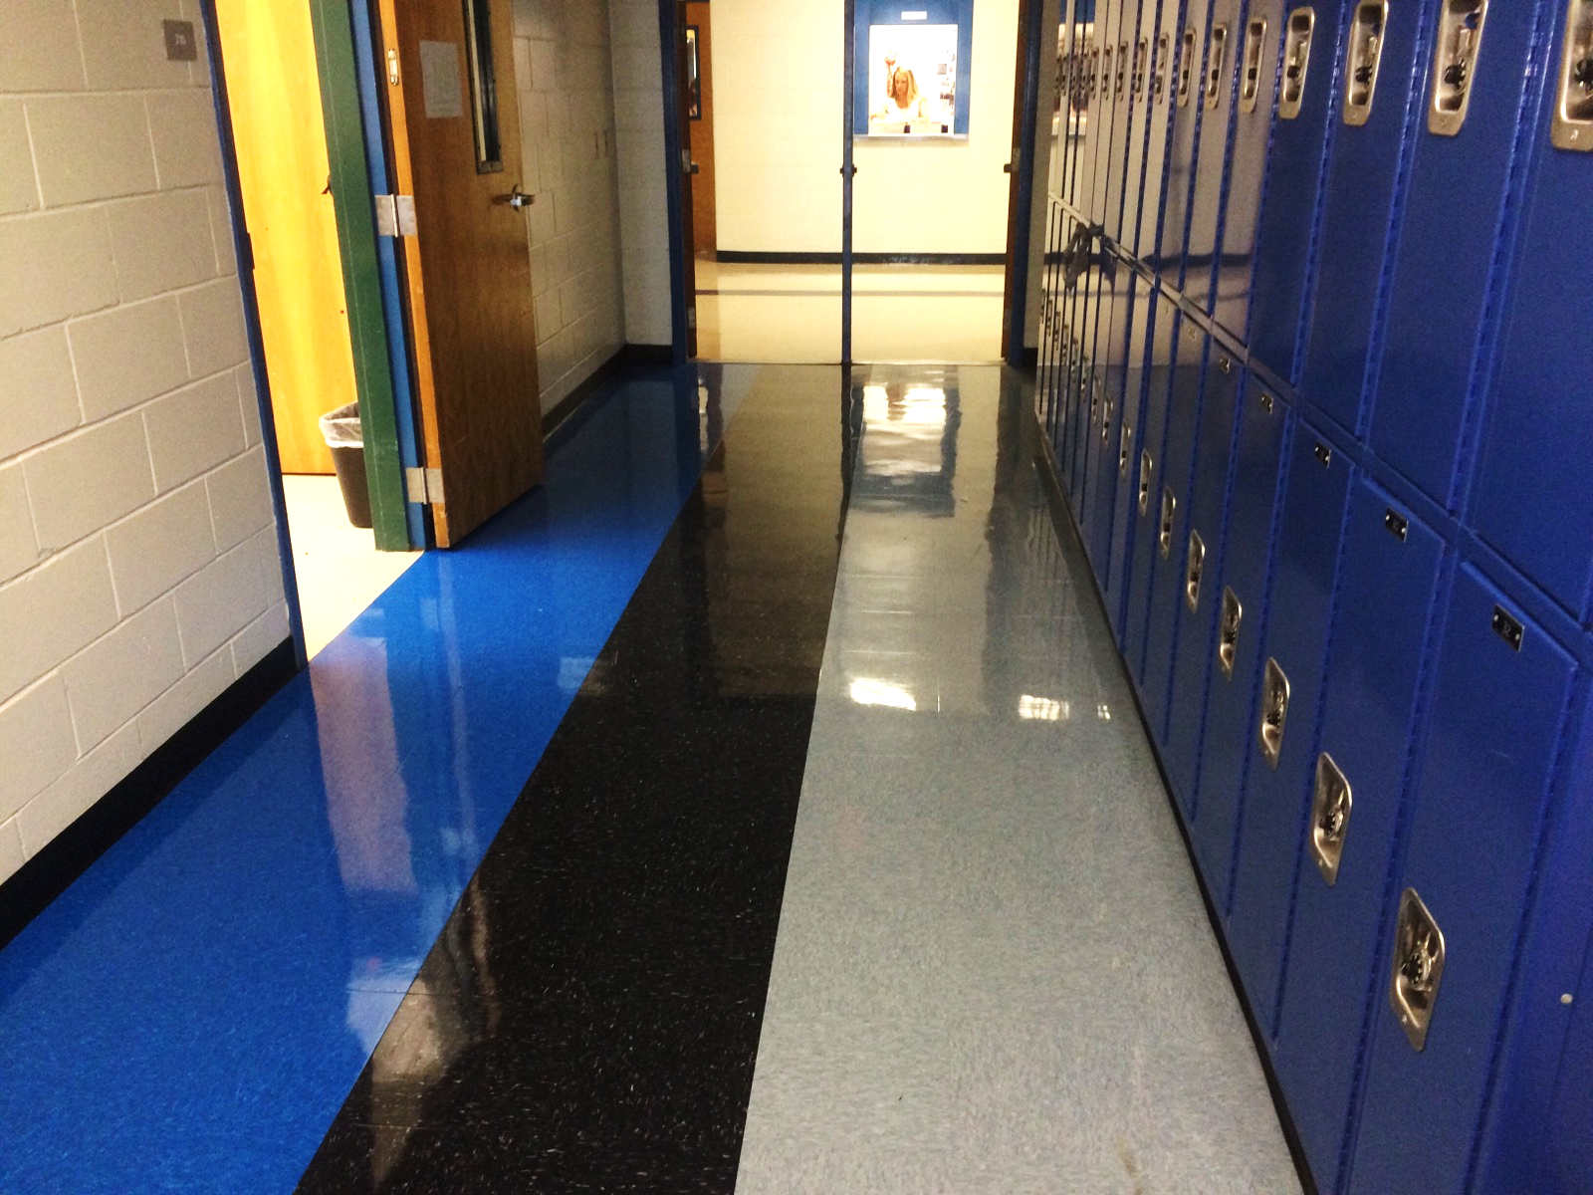
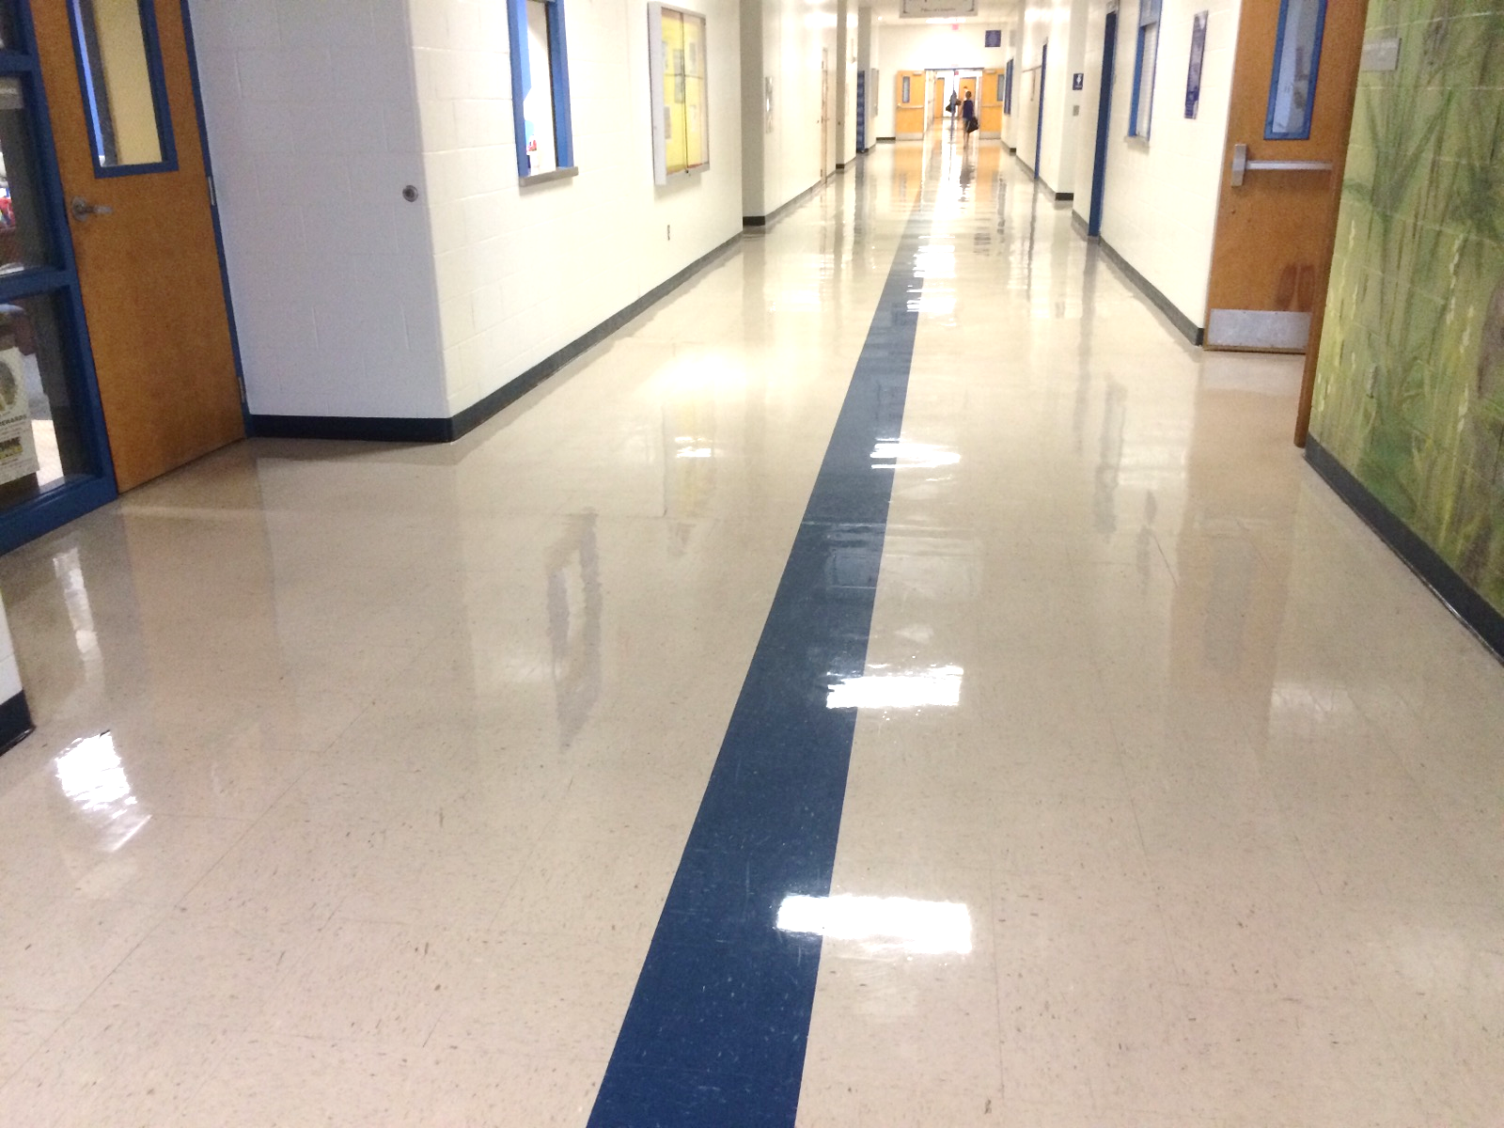
Hallways
The hallways are crowded. It is imperative that you walk on the right side of the halls.
Walk forward at all times paying attention to others around you. Do NOT Run!
In the smaller hallways, you can NOT walk two or three side by side. You have to walk single file to allow enough room for students to access their lockers and for traffic to flow both directions.
NO ROAMING! A demerit for defiance will be given to those who roam.
Small Hallways—“Down on BLUE; Back on BLACK”!
Gray Tiles are “Neutral Zones” for lockers
Main Hallways—Stay to the right of the blue!

Slide 12

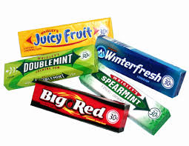
NO GUM! EVER!
Chewing gum is not allowed on campus.
Violations result in a demerit

Slide 13



Water Only

Slide 14
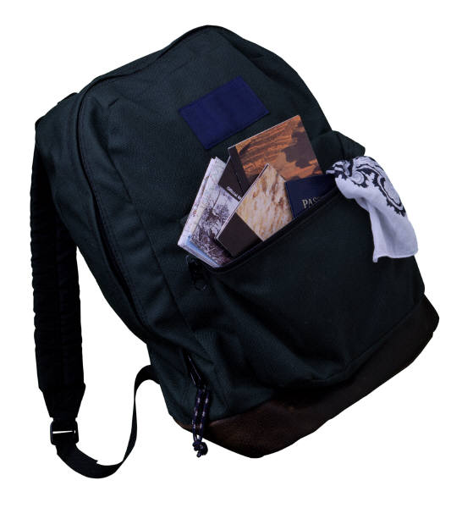
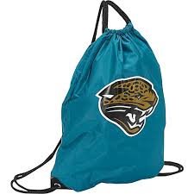
BOOKBAGS
CAN BE USED TO AND FROM SCHOOL ONLY
KEEP YOUR BOOKBAG IN YOUR LOCKER
USE A STRING BAG DURING THE DAY

Slide 15

LOCKERS/LOCKS
Not enough time to go to locker in between EVERY class.
LOCK YOUR LOCK
Do NOT share your combination

Slide 16


PUT THE CELL PHONES AWAY
Cell phones are not allowed “on your person”.
They can not be in your pockets.
They must be turned off and placed in a
book bag, purse or locker.
They may not be used during the school day
which INCLUDES morning drop-off or at dismissal.
Your phone will be confiscated!
“I was texting my mom.”

Slide 17




Social Media
Do not post anything that you wouldn’t want your Grandparent to see.
Nothing is private . . . expect it to be “screen shotted”, forwarded and shown to everyone!!!!
If you see anything inappropriate tell a trusted adult.
DELETE does not mean DELETE!!!

Slide 18
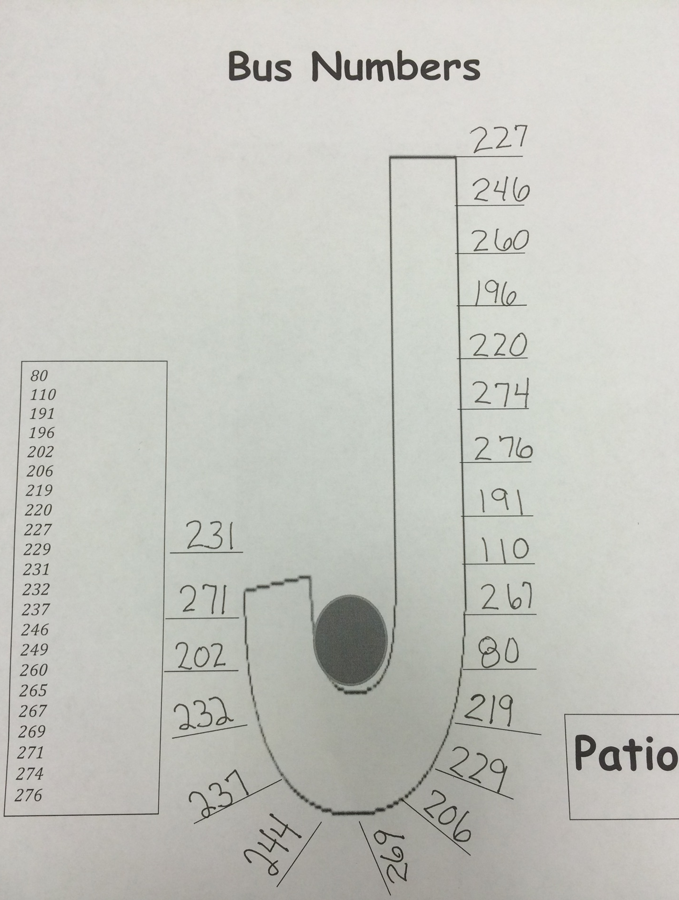
Buses
  Riding the bus is a privilege and you can be removed from the bus if you cannot act appropriately
  Bus stop is considered “school,” the same rules at school apply to the bus stop.
Face the front
Conversational voices
Classroom rules apply
Violations result in bus referrals
Referrals can result in loss of riding privilege
NO BUS PASSES
NO BUS PASSES
NO BUS PASSES

Slide 19
CAFETERIA/PATIO
Get in line as soon as you arrive. No skipping in line.
IF YOU TOUCH A FOOD ITEM THEN YOU MUST BUY IT.
Get everything you need when you go through the line, no going back in to the line
One Raider Buck to eat on the patio. “Spiritwear Out” every Friday.
Do not touch anyone else’s food.
Cafeteria is monitored by video, do NOT leave your trash! Eating in the cafeteria is a privilege, not a right!
No switching seats.
Recycle CORRECTLY!

Slide 20

Do’s
Relax!
Eat ONLY on tile
Talk with friends
Read personal books
Play Games
Enjoy Maker’s Space
Work on homework
Clean up after yourself
Check out SPMS books
Follow all school rules
Only 30 students per lunch
1st come, 1st served
Don’ts
Leave a mess at your table.
Be disruptive or rude.
Read SPMS books while eating or drinking.
Eat on the carpet.
Leave your backpacks in the walkways

Slide 21


RAIDER BUCK$
Must have your name & teacher signature to use or will be confiscated.
Cannot give your bucks to another student
Use them for ice cream on Fridays and/or to sit outside on the patio.

Slide 22
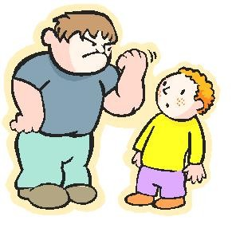
DON’T BE A BULLY!
Report Any Bullying
Consequences can be severe up to and including suspension and/or arrest
Tell Us When Something Isn’t Right!

Slide 23

HORSEPLAY RESULTING IN INJURY
Can result in suspension
Length of suspension depends on severity of injury- not the intent!
KEEP YOUR HANDS AND FEET TO YOURSELF!

Slide 24
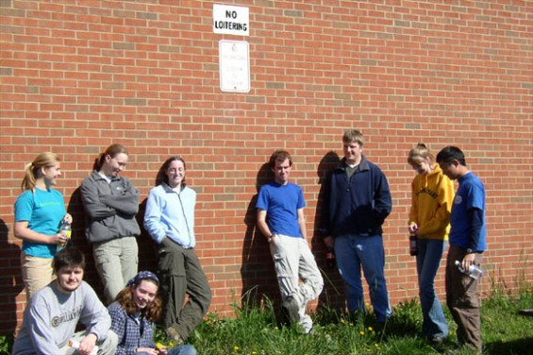
Dismissal
Top & bottom lockers are released separately for safety reasons. After you access your locker, you need to exit the building. There is NO waiting for friends or roaming around. If you need to see a teacher or use the restroom, do so BEFORE you access your locker. Demerits will be given to those who are roaming.
No cell phones, if you have a cell phone out it will be confiscated (NO PHONES ANYWHERE ON CAMPUS: FRONT LOOP or BUS LOOP)
Do not hang around, roam around, and stop and talk (Bikers and walkers need to leave when dismissed)

Slide 25

Stealing
If you take anything that does not belong to you, it is STEALING!
Does not matter how small it is (gum, candy, 1 chicken nugget)
Stealing WILL RESULT in an automatic (minimum) 1 day out of school suspension
May result in charges being filed

Slide 26


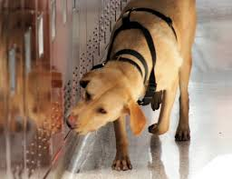
KNIVES and other CONTRABAND
WHAT TO DO IF YOU ACCIDENTALLY BRING IT TO SCHOOL:
Bring it immediately to a staff member (Teacher, coach, dean, principal)
Holding on to it may result in suspension and more severe consequences

Slide 27


All level 4 offenses (alcohol, drugs, battery, weapons, contraband, major acts of misconduct, etc.) are automatically a 10 day suspension AND Gaines referral for alternate placement.
Gaines placement can be a 45 or 90 day placement (or more)
Off campus felony arrest
Gaines placement does not end because school year does, it carries over to next year!

