Slide 1
School Advisory Council - SAC
MAY 14th, 2024

Slide 2
MEMBERs Attendance
Present | Member Name | Present | Member Name
X | Chris McLiverty, Chair | X | A Cox , Co-chair
 | Linda Carnall, Principal | X | Jen Corte, Support Staff
X | Marie Young (parent) |  | Chrissy Tarpey (Parent)
X | Nancy Tray (parent) | X | Stephanie Kluge (Parent)
 | Amy Means (parent) | X | Dave Holden (Parent)
X | Dawn Evans (parent) | X | Melissa Sevestre (Parent)
 | Becky Jarriel (District Support Person)
staff 3, 6 parents Quorum: Yes

Slide 3
Call meeting to Order
Agenda Adoption
Approve April Minutes
Principal’s Report
Financial Report
Adjournment

Slide 4
ADOPTION OF AGENDA w/ flexibility
Call meeting to Order
Agenda Adoption
Approve April Minutes
Principal’s Report
Financial Report
Adjournment

Slide 5
ADOPTION OF AGENDA w/ flexibility
Call meeting to Order
Agenda Adoption
Approve April Minutes
Principal’s Report
Financial Report
Adjournment
Motion to approve:
2nd Motion:

Slide 6
Call meeting to Order
Agenda Adoption
Approve April Minutes
Principal’s Report
Financial Report
Adjournment

Slide 7
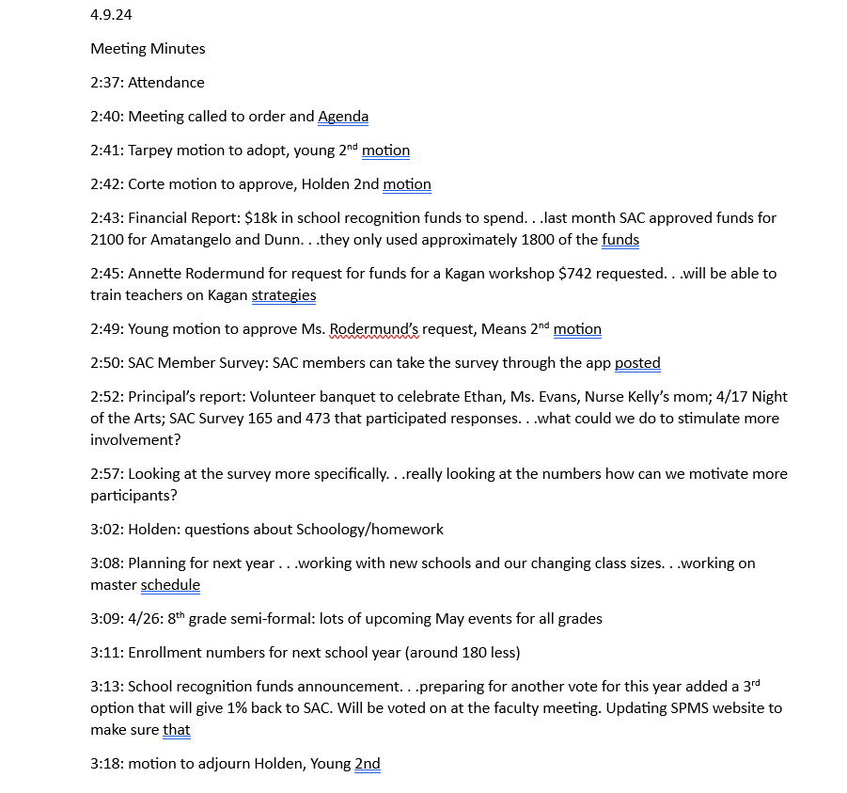
APPROVE APRIL MINUTES

Slide 8
Motion to approve:
2nd Motion:
APPROVE APRIL MINUTES

Slide 9
Call meeting to Order
Agenda Adoption
Approve April Minutes
Principal’s Report
Financial Report
Adjournment

Slide 10
PRINCIPAL’S REPORT - Ms. Carnall
Celebrations:
Teacher Appreciation
8th grade formal and Gradventure
Retirements
Upcoming events:
May 20: Locker Clean out, Yearbook distribution
No more backpacks after this date-string bags and lunch boxes only
May 22: 7th grade field trip, 8th grade Kona Ice and EOY video 8th grade raffle
May 23:6th grade field trip, 7th grade raider raffle,8th awards and student/staff basketball game
May 24: 6th Raider Raffle

Slide 11
Call meeting to Order
Agenda Adoption
Approve April Minutes
Principal’s Report
Financial Report
Adjournment

Slide 12
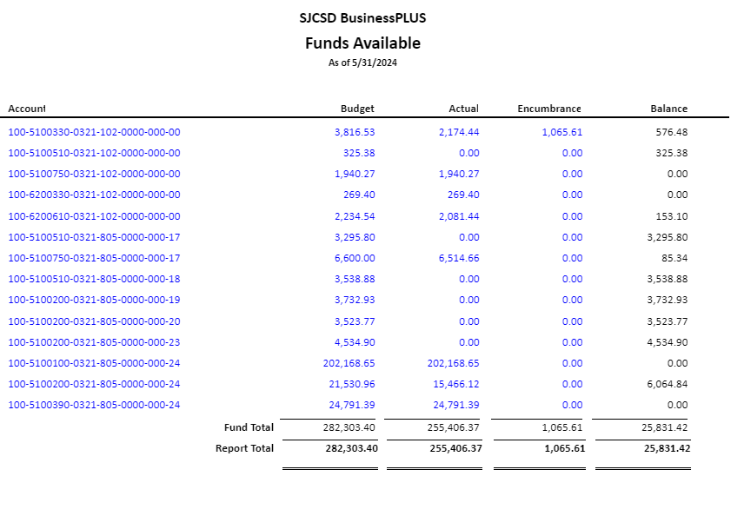
FINANCIAL REPORT
$25,831.42

Slide 13
Call meeting to Order
Agenda Adoption
Approve April Minutes
Principal’s Report
Financial Report
Adjournment

Slide 14
ANY FURTHER DISCUSSIONS?

Slide 15
Call meeting to Order
Agenda Adoption
Approve April Minutes
Principal’s Report
Financial Report
Adjournment

Slide 16
ADJOURNMENT
Have a wonderful summer with your kids!

